Slide 1
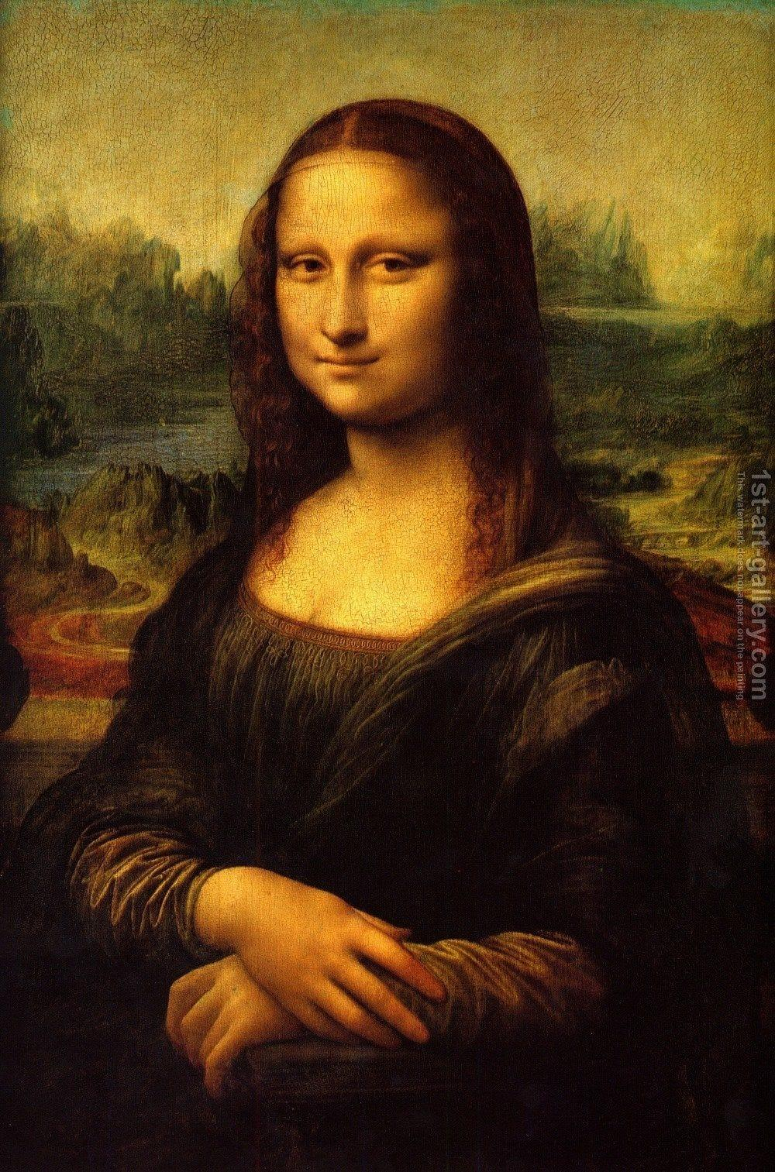
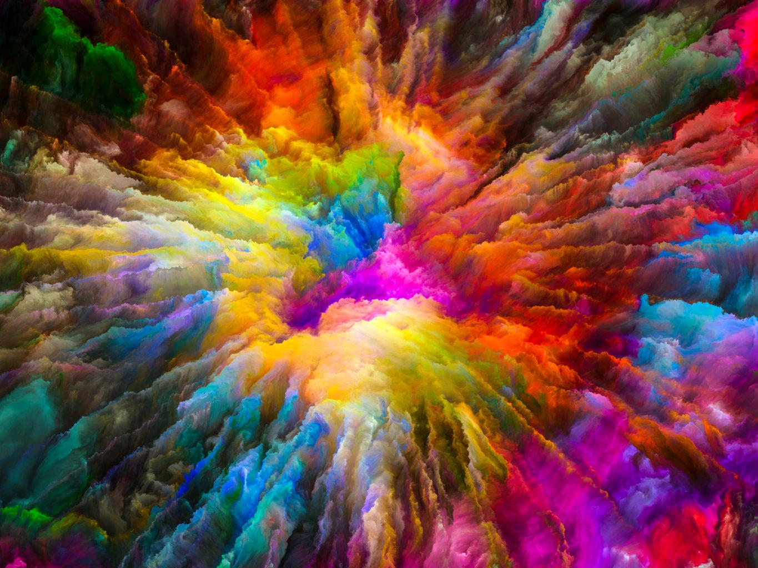
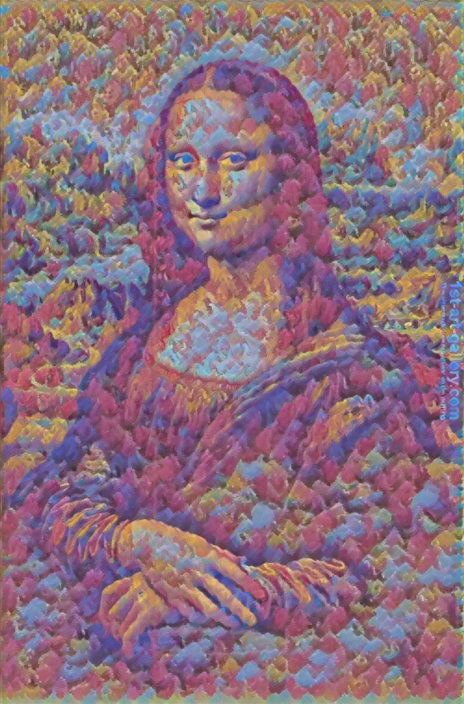
Neural Style Transfer
+
=

Slide 2
What is Artificial intelligence(AI)?
Artificial intelligence is the simulation of human intelligence processes by machines, especially computer systems. Specific applications of AI include expert systems, natural language processing, speech recognition and machine vision.
It is the science and engineering of making intelligent machines, especially intelligent computer programs. It is related to the similar task of using computers to understand human intelligence, but AI does not have to confine itself to methods that are biologically observable.

Slide 3
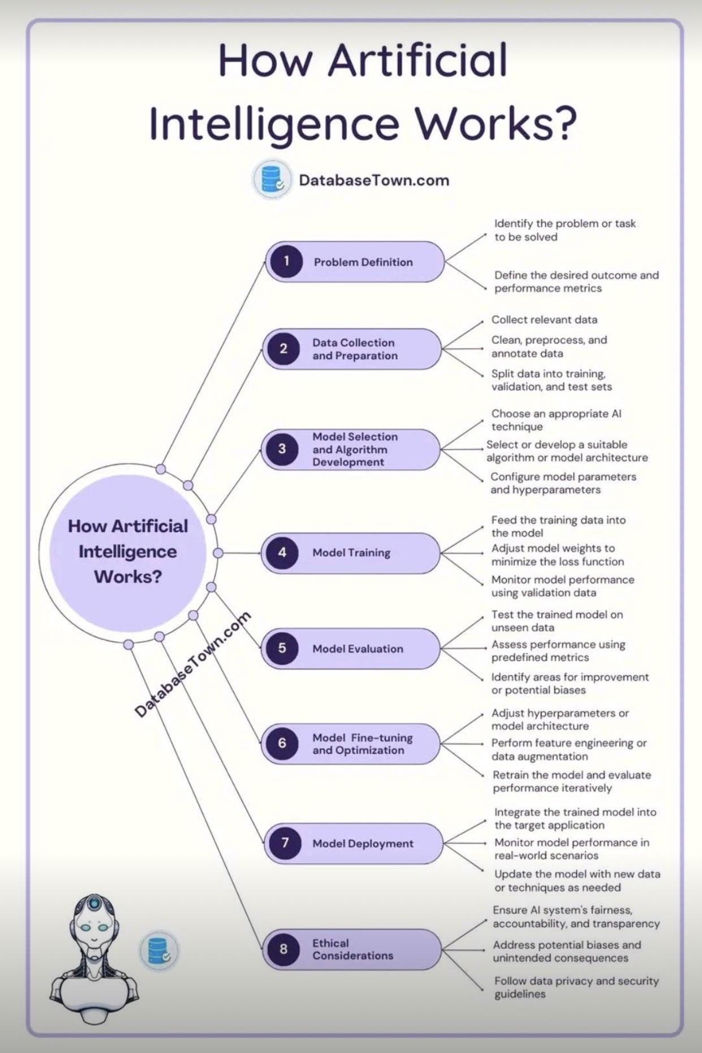
How Artificial Intelligence Works?
Learning :- This aspect of AI programming focuses on acquiring data and creating rules for how to turn it into actionable information.
Reasoning :- This aspect of AI programming focuses on choosing the right algorithm to reach a desired outcome.
Self-correction :- This aspect of AI programming is designed to continually fine-tune algorithms and ensure they provide the most accurate results possible.
Creativity :- This aspect of AI uses neural networks, rules-based systems, statistical methods and other AI techniques to generate new images, new text, new music and new ideas.

Slide 4
Working with Artificial Intelligence.
Artificial intelligence is not here to replace us. It augments our abilities and makes us better at what we do. Because AI algorithms learn differently than humans, they look at things differently. They can see relationships and patterns that escape us. This human, AI partnership offers many opportunities. It can:
Bring analytics to industries and domains where it’s currently underutilized.
Improve the performance of existing analytic technologies, like computer vision and time series analysis.
Break down economic barriers, including language and translation barriers.
Augment existing abilities and make us better at what we do.
Give us better vision, better understanding, better memory and much more.

Slide 5
Neural Style Transfer
Neural Style Transfer is a technique that allows us to generate an image with the same "content" as a base image, but with the "style" of our chosen picture.
It is an application of Computer Vision, Neural style transfer is an optimization technique used to take two images a content image and a style reference image (such as an artwork by a famous painter) and blend them together so the output image looks like the content image, but “painted” in the style of the style reference image.
Neural style transfer (NST) is a very neat idea. It builds on the key idea that,
“It is possible to separate the style representation and content representations in a CNN, learnt during a computer vision task (e.g. image recognition task).”

Slide 6
How does Neural Style Transfer work?
Style transfer works by activating the neurons in a particular way, such that the output image and the content image should match particularly in the content, whereas the style image and the desired output image should match in texture, and capture the same style characteristics in the activation maps.
These two objectives are combined in a single loss formula, where we can control how much we care about style reconstruction and content reconstruction.
Here are the required inputs to the model for image style transfer:
A Content Image – An image to which we want to transfer style to
A Style Image – The style we want to transfer to the content image
An Input Image (generated) – The final blend of content and style image

Slide 7

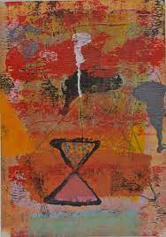
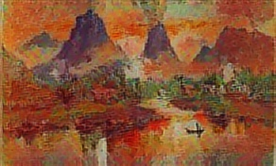
Neural Style Transfer Generated Image
+
=

Slide 8
Libraries for Neural Style Transfer
Deep Learning Deep Learning is a subset of Machine Learning based on Artificial Neural Networks. The main idea behind Deep Learning is to mimic the working of a human brain. Some of the use cases in Deep Learning involves Face Recognition, Machine Translation, Speech Recognition, etc. Learning can be supervised,
semi-supervised, or unsupervised.
TensorFlow
TensorFlow is an end-to-end open source platform for machine learning. TensorFlow is a rich system for managing all aspects of a machine learning system; however, this class focuses on using a particular TensorFlow API to develop and train machine learning models.
Neural Network
A neural network is a series of algorithms that endeavors to recognize underlying relationships in a set of data through a process that mimics the way the human brain operates. In this sense, neural networks refer to systems of neurons, either organic or artificial in nature

Slide 9
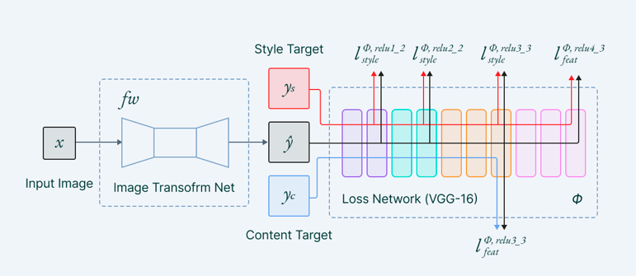
Neural Style Transfer basic structure

Slide 10
Loss Functions
To get the desired image we will have to define a loss function which will optimize the losses towards the required result.Per Pixel Loss is a metric that is used to understand the differences between images on a pixel level. It compares the output pixel values with the input values. (Another method is perpetual loss functions we will discuss briefly at the later stages of the blog). Sometimes per pixel loss has its own drawbacks in terms of representing every meaningful characteristic. That’s where perpetual losses come into the picture. The loss terms we will be focusing on will be-
Content Loss
Style Loss

Slide 11


Content Loss
Content loss is calculated by Euclidean distance between the respective intermediate higher-level feature representation of input image (x) and content image (p) at layer l.
It makes sure the content we want in the generated image is captured efficiently. It has been observed that CNN captures information about the content in the higher levels of the network, whereas the lower levels are more focused on the individual pixel values.

Slide 12
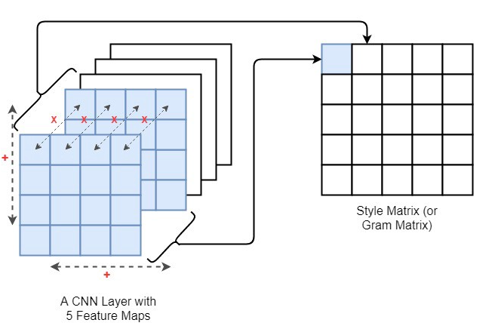
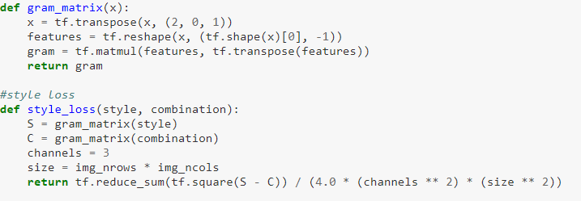
Style Loss
Style loss is conceptually different from Content loss. The style information is measured as the amount of correlation present between the feature maps per layer. Here we use the Gram Matrix for computing style loss.
Gram matrix is a way to interpret style information in an image as it shows the overall distribution of features in a given layer. It is measured as the amount of correlation present between features maps in a given layer.

Slide 13
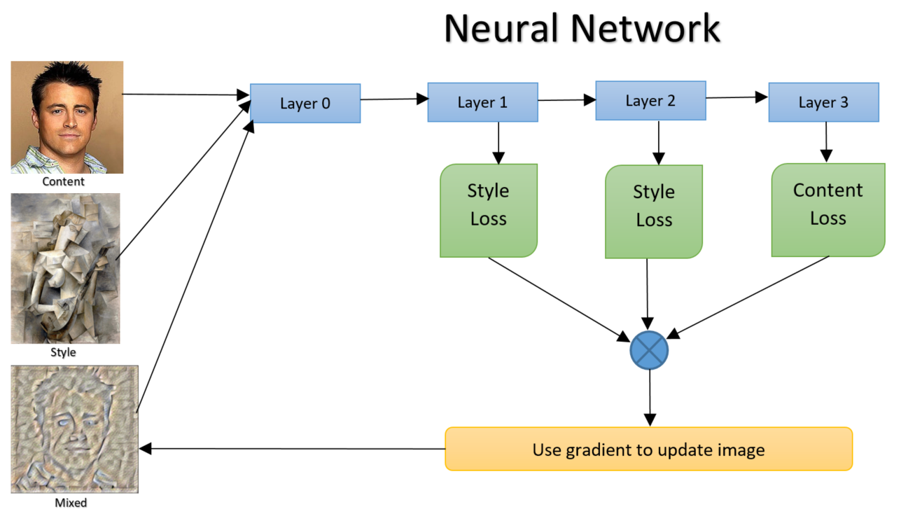
Loss Function Structure

Slide 14
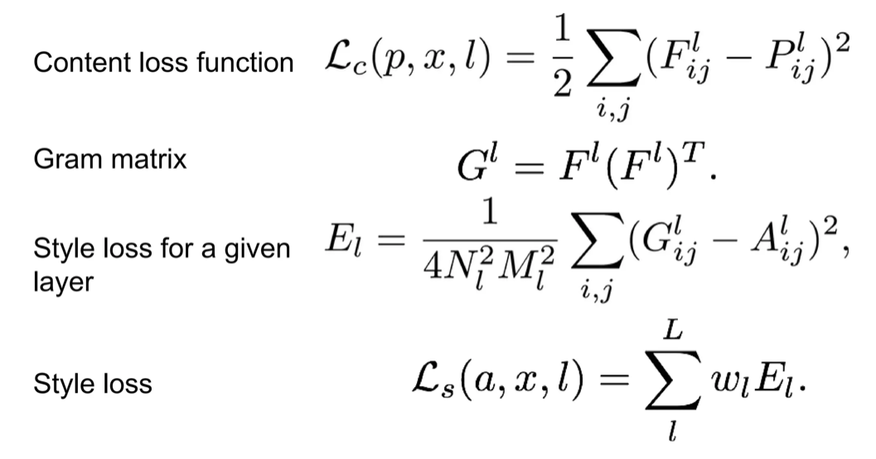
Calculations For Loss Function

Slide 15
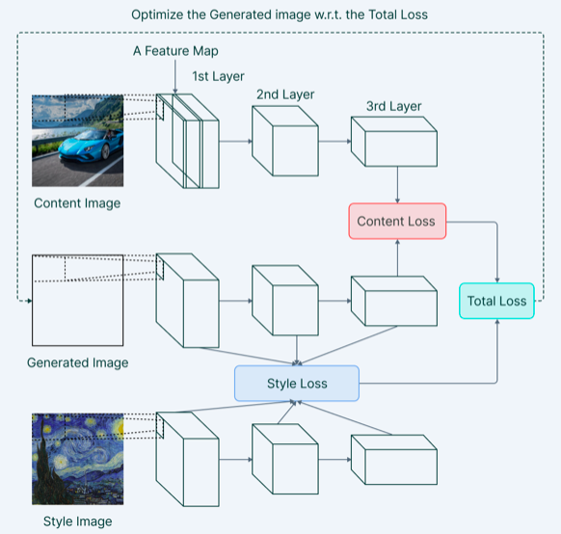
Model architecture overview
The architecture of the Neural Style Transfer can be designed in such a way that it can range from applying a single style in an image to allowing mix and match of multiple styles.

Slide 16


